Slide 1


Data Visualization Design
SCALING THE MARKETPLACE WITHOUT BREAKING CUSTOMER EXPERIENCE
Bscs4001
May 2026 T2

Slide 2


Team Members
Daaris
21f1001365
Shubham Tiwari
22f1001934
Deepak Kumar
21f2000818
Ayush Vats
22f1000784
Ravina
21f2001128

Slide 3
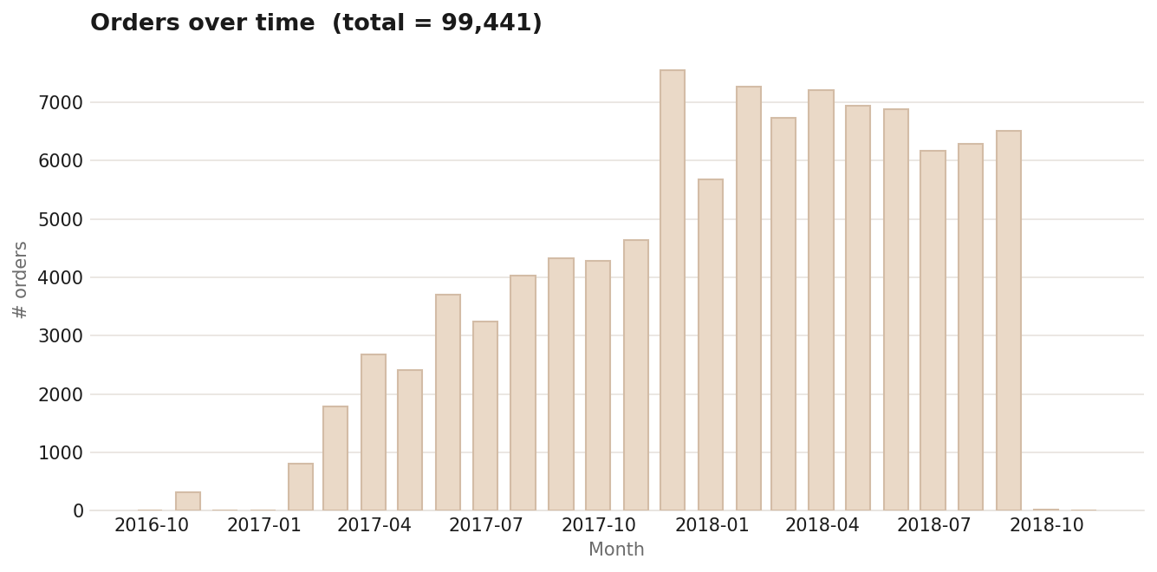
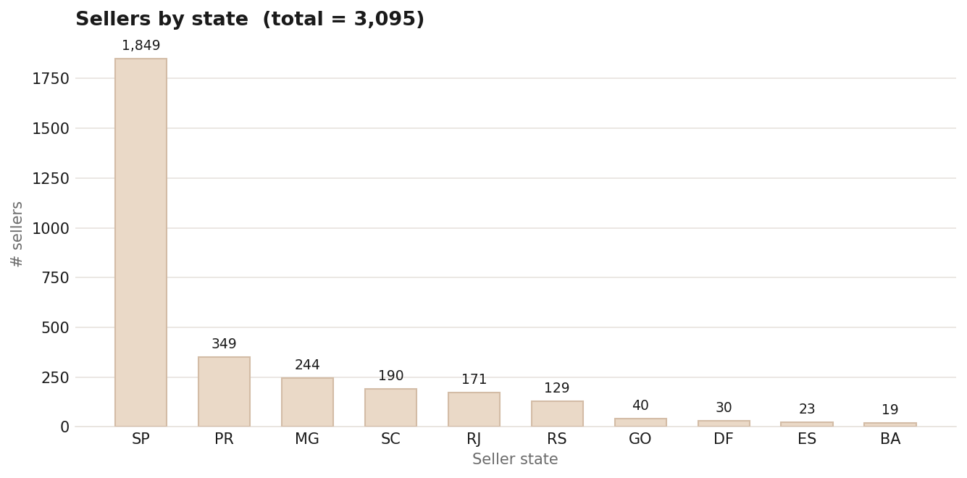


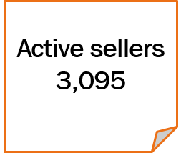
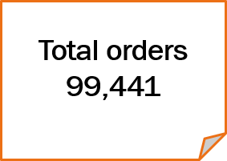
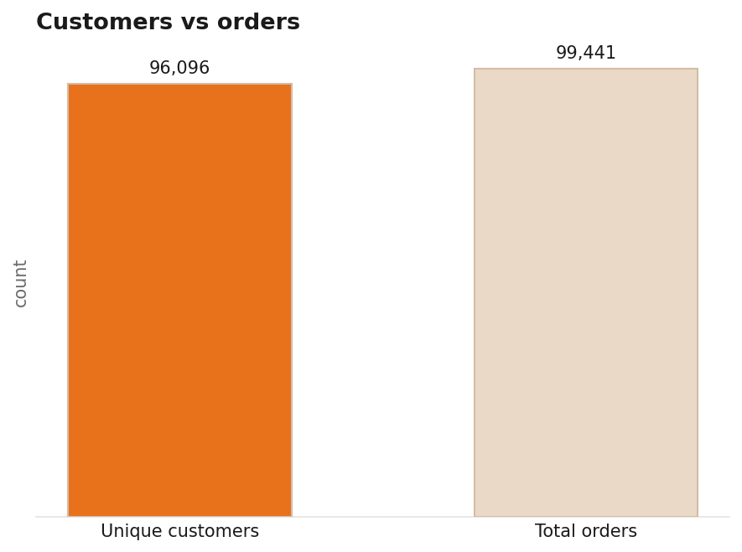
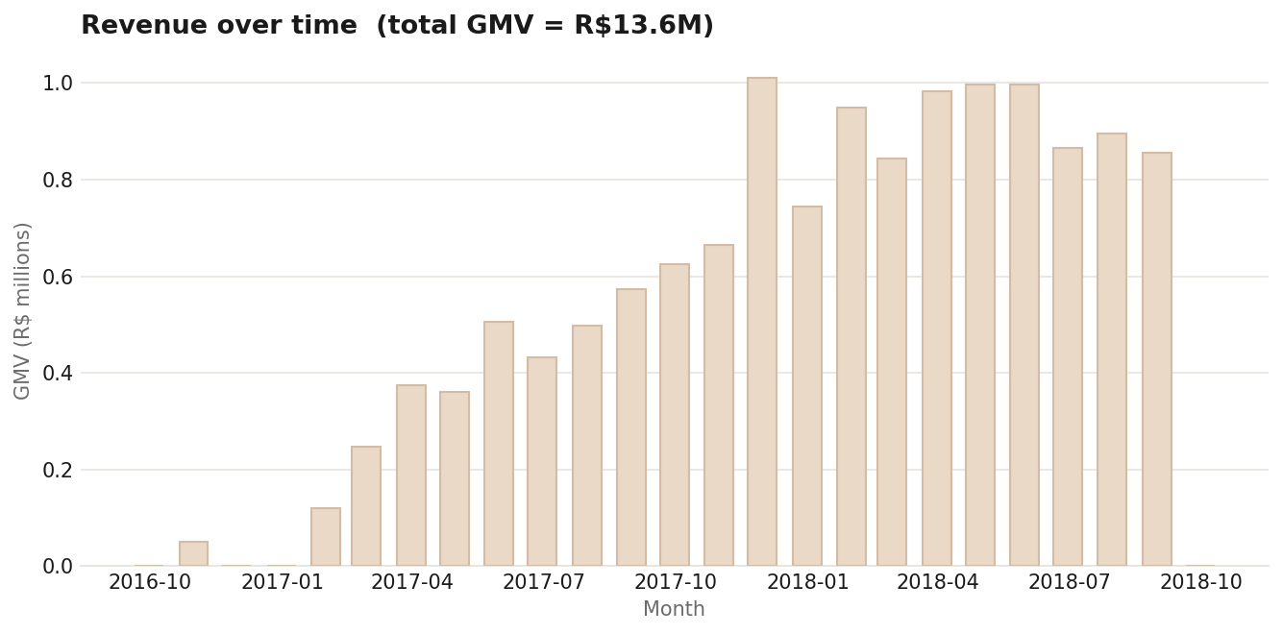


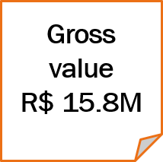
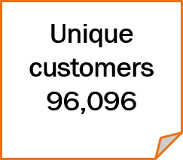

Slide 4
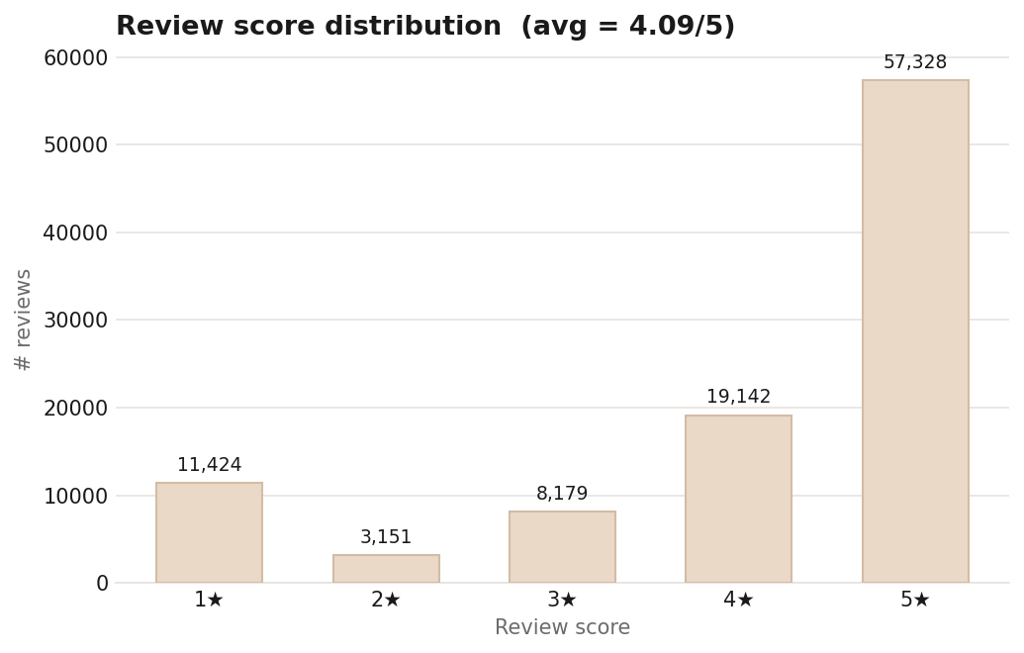
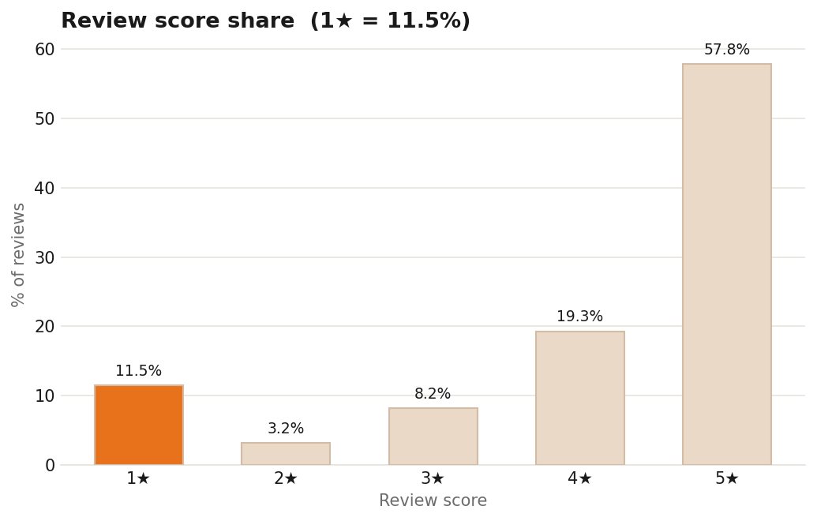


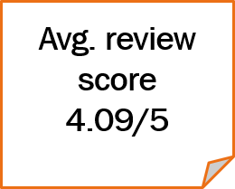
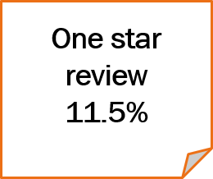
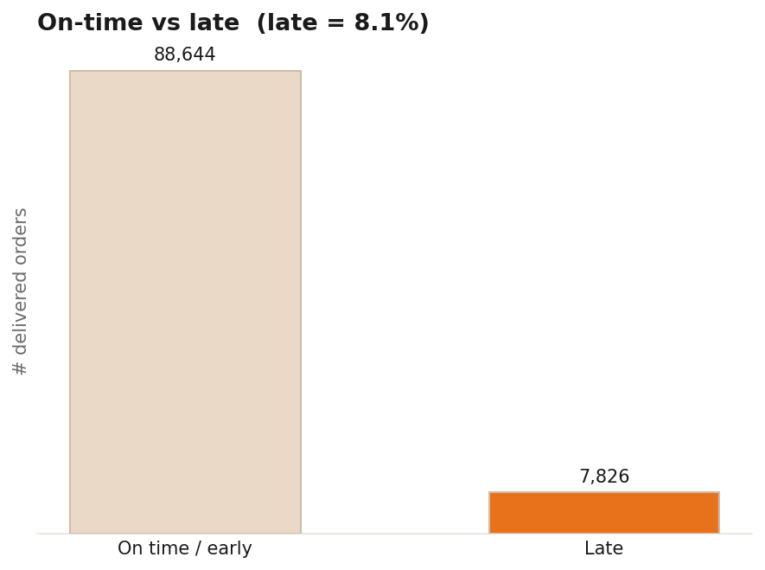
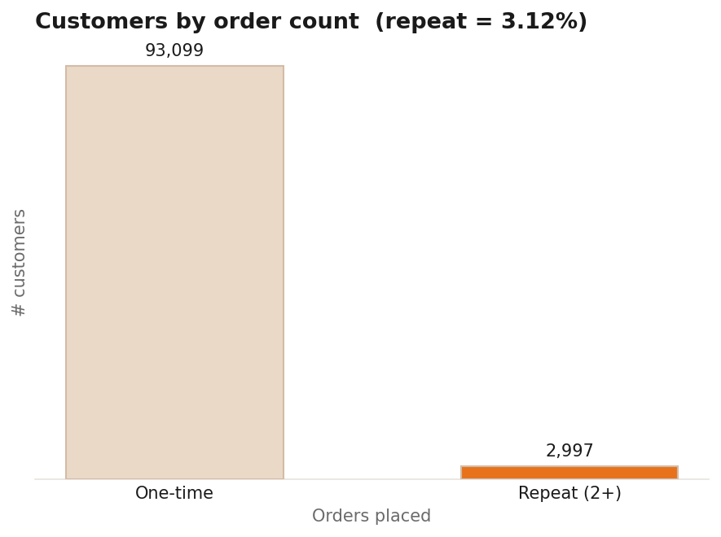


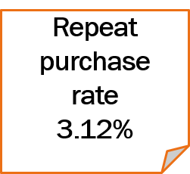
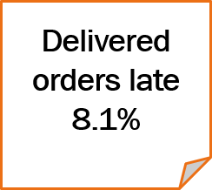

Slide 5
Problem Statement :
How can the marketplace grow without breaking the customer experience ??
Marketplace
Grow seller base fast
Onboard aggressively
Risk to quality
Late, poor ,unhappy
Protect quality
Cut weak sellers
Slower growth
Smaller catalogue
Grow the seller base fast and risk quality
Protect quality by cutting weak sellers & slow growth

Slide 6
Deliver
Make on time delivery be the top operational priority
Late arrive costs 1.72 stars –the strongest signal in the data.
Retain
Convert one time buyer into repeat customers
Only 3.12% ever buy twice –growth requires customer retention
Grow
Raise basket size through cross-sell
90.1% of orders hold one item –the cheapest lever available
Solutions

Slide 7
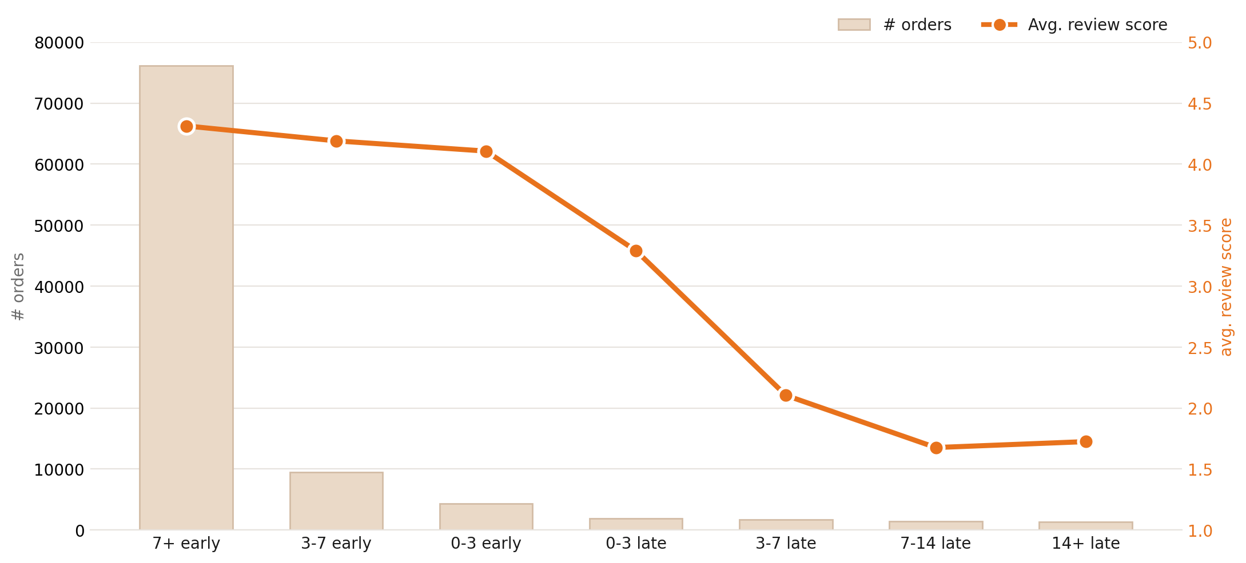
Average review score falls from 4.29 (on time / early) to 2.57 the moment an order is late
-1.72 drop in avg review score
Treat “days late” as the control variable: defend the estimated-delivery date and intervene before it is missed.
Make on time delivery the top operational priority
Delivery
Decision 1

Slide 8

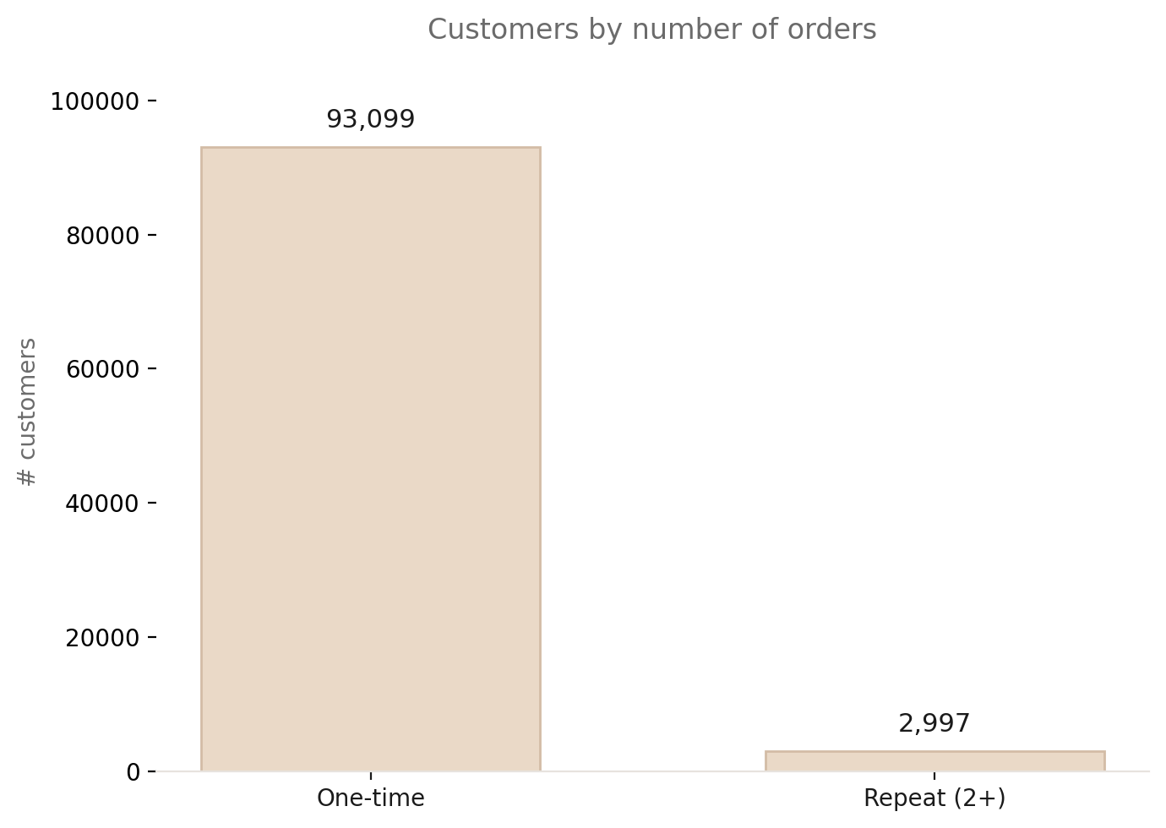
3.12%
Only 2,997 of 96,096 customers ever place a second order — the rest buy exactly once.
Growth to date is almost entirely acquisition. Because a late first delivery costs ~1.7 stars, Decision 01 and this one reinforce each other: fixing delivery protects the repeat base
Convert one time buyers into repeated customers
Buyers
Decision 2

Slide 9
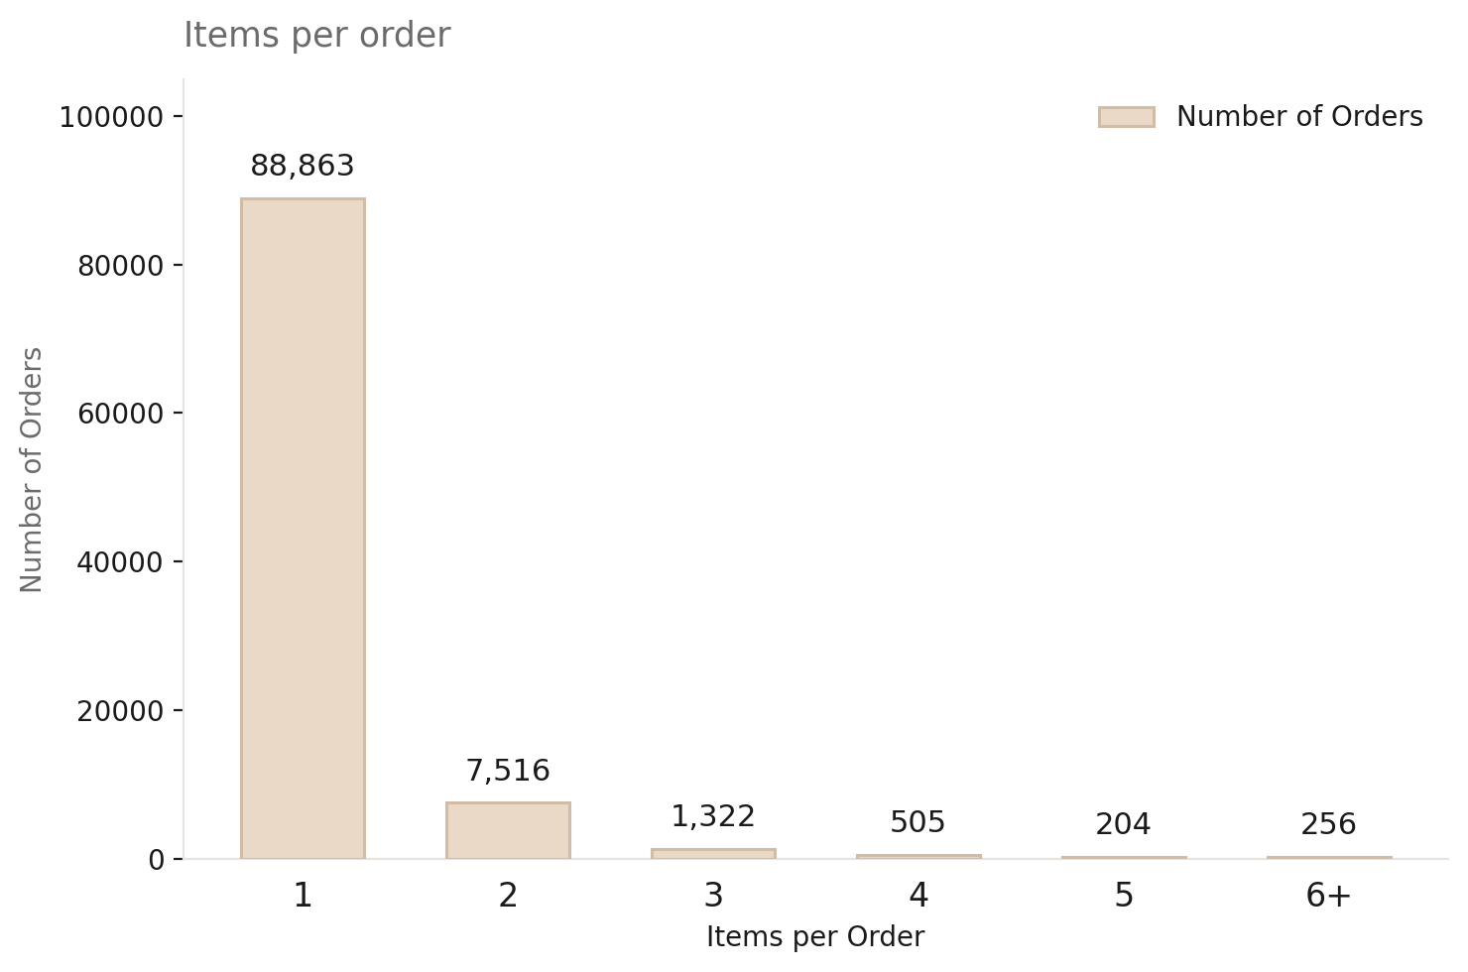
90.1 % of orders contain exactly one item — basket-building is barely happening today
Add “frequently bought together” and curated bundles
Set a free-shipping threshold above the single-item price
Suggestions
Raise basket size through cross sell
Basket size
Decision 3

Slide 10
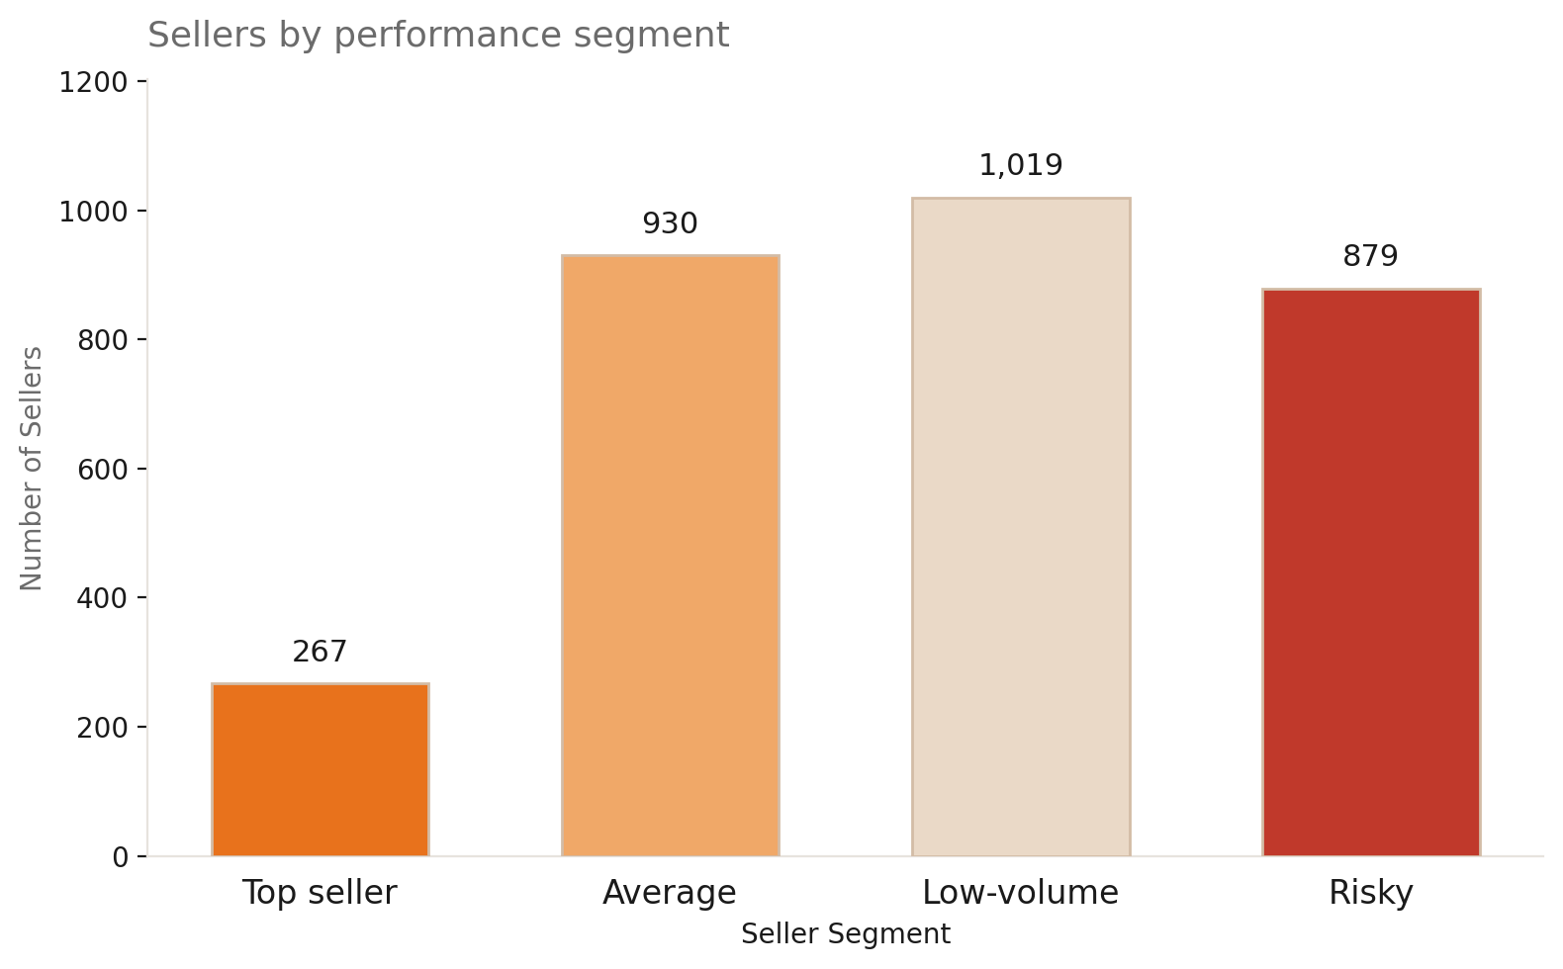
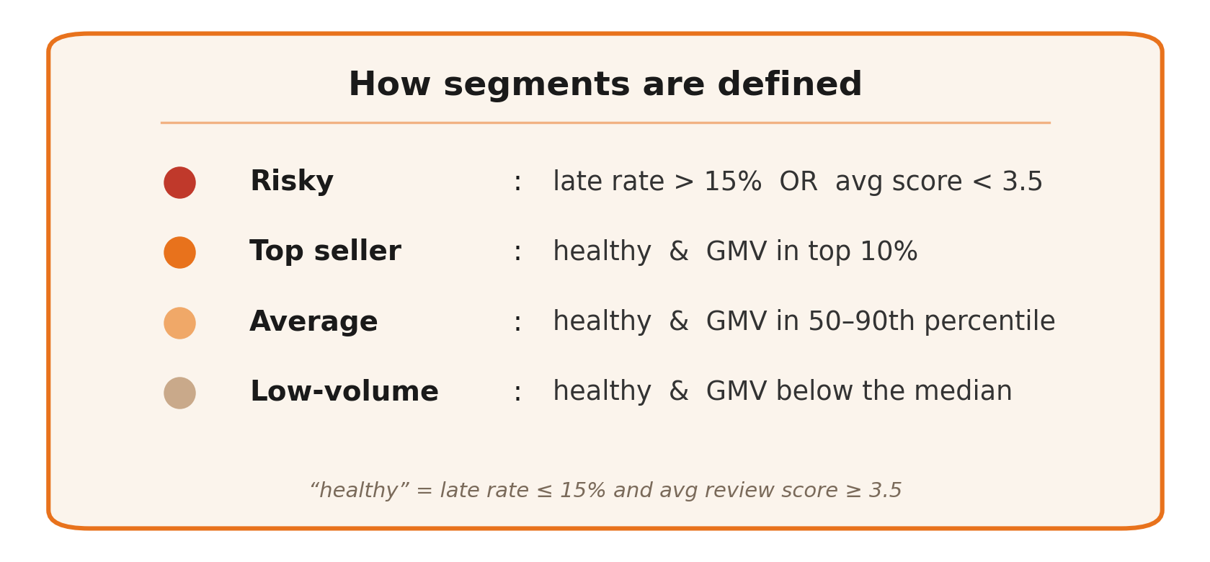
Seller's performance categories

Slide 11
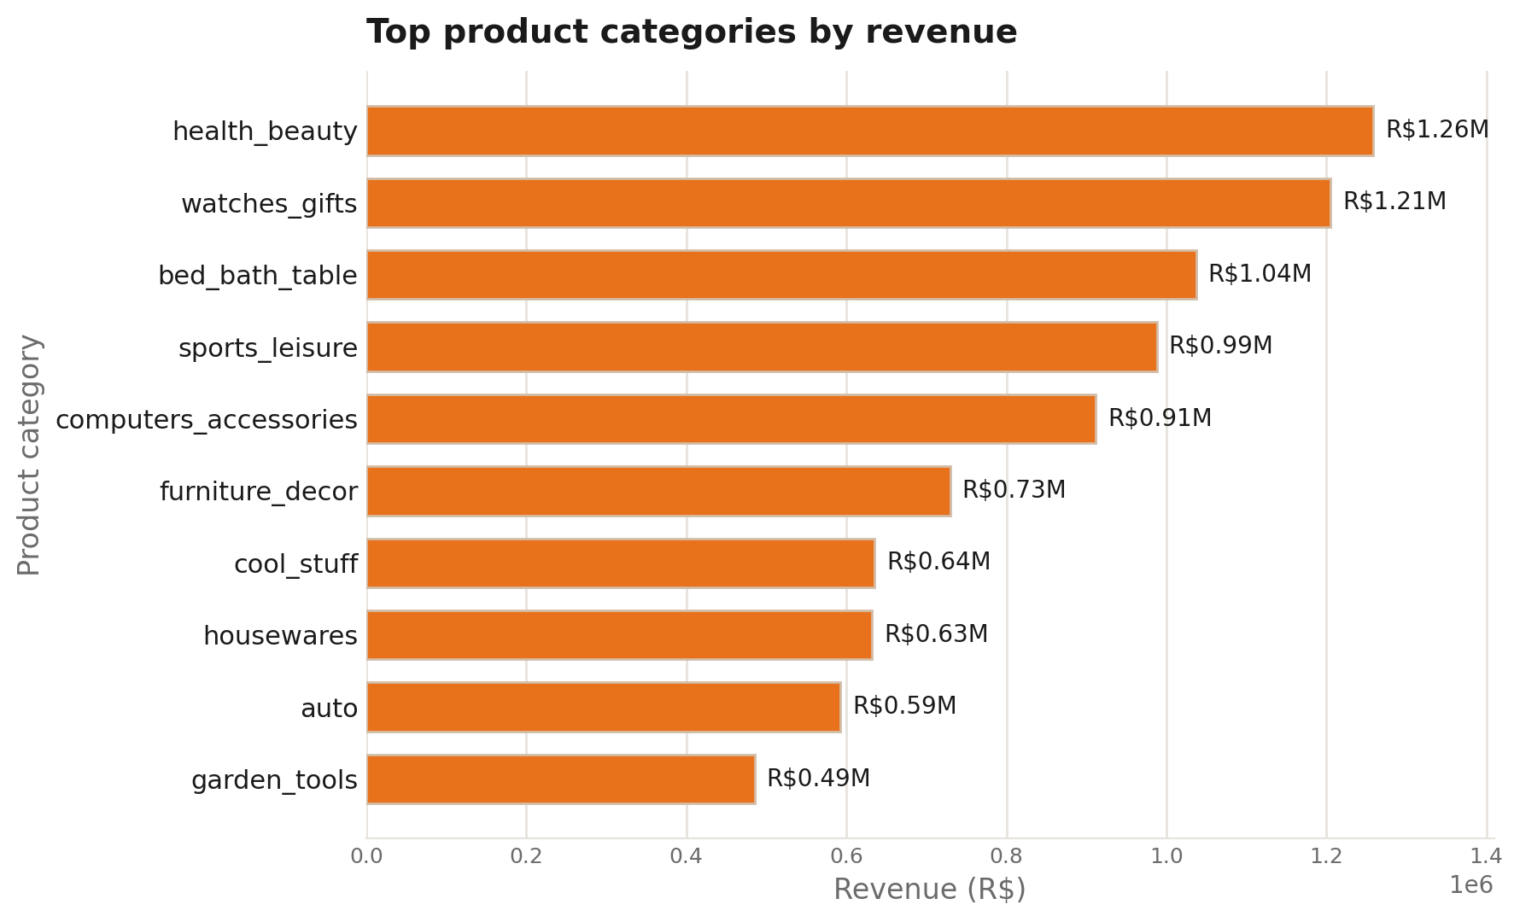
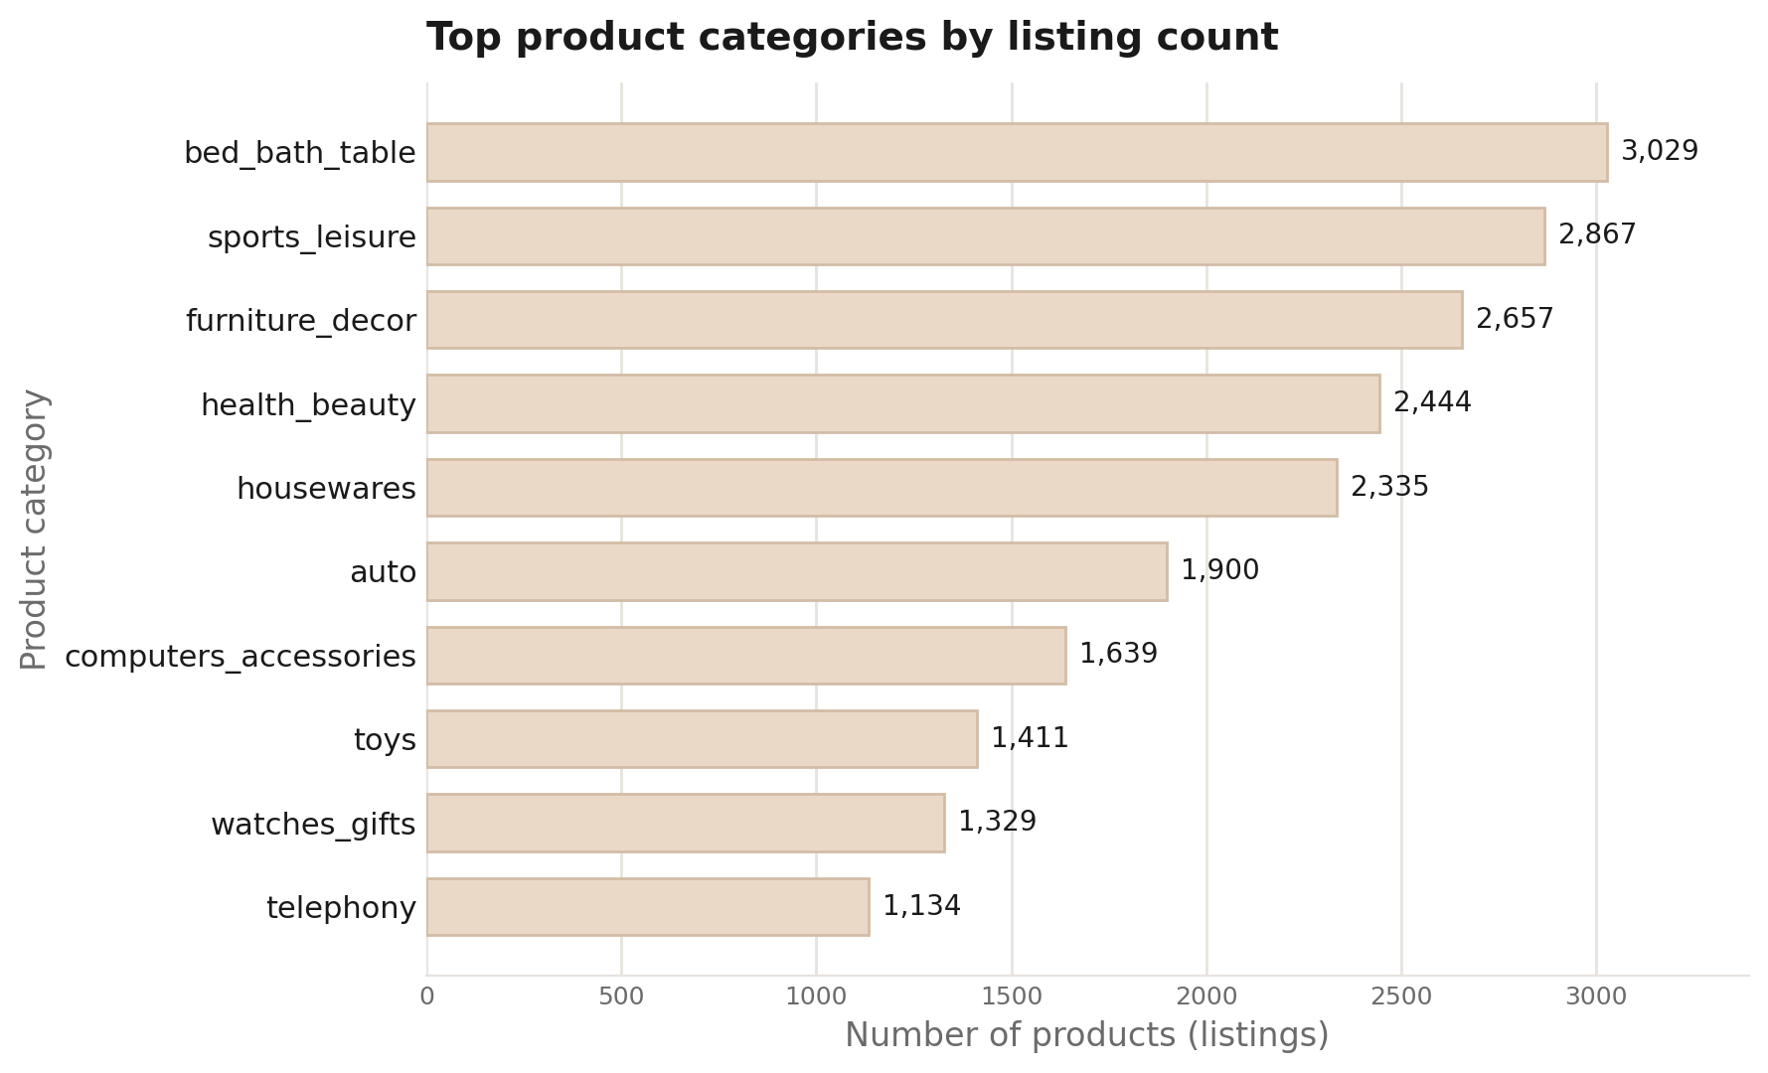
Top product categories

Slide 12

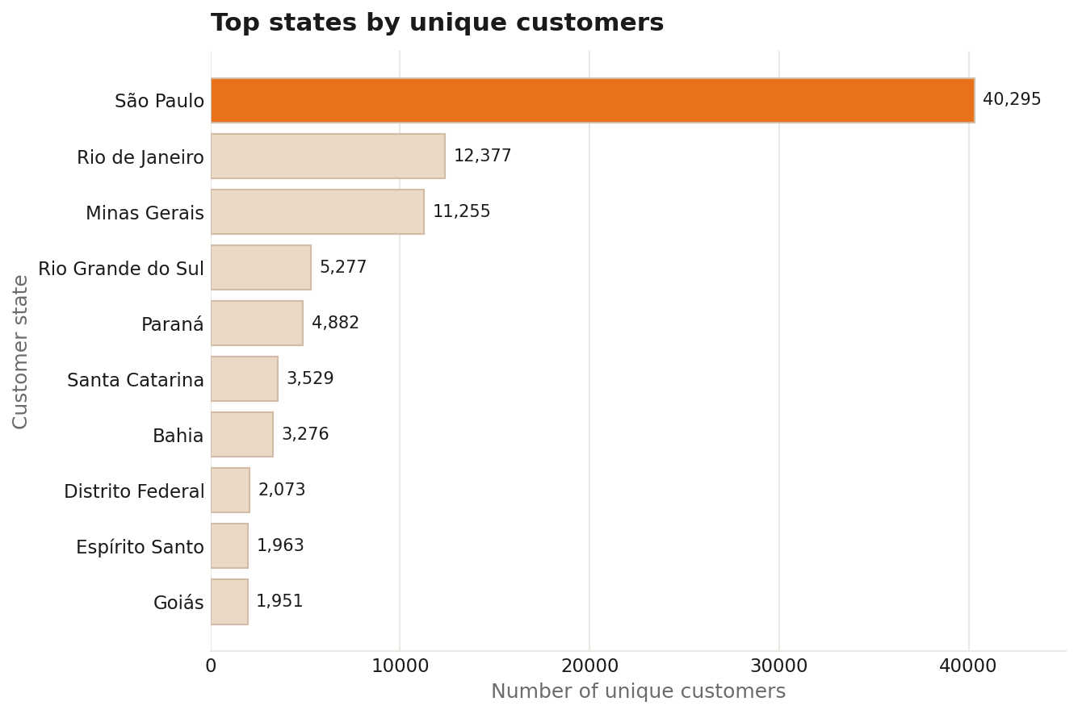
No. of customers in the geographical locations

Slide 13
Time to demonstrate our website

